Slide 1

CMMI
PRESENTED BY:
SIDDHANT GAWAI
21102B0007
TE CMPN-B

Slide 2

WHAT IS CMMI?
CMMI, or the Capability Maturity Model Integration, is a framework that helps organizations improve their processes and systems by providing a set of best practices and guidelines for development and service delivery. It focuses on achieving higher levels of process maturity and quality in various industries.

Slide 3
WHY WAS CMMI INTRODUCED?
Since CMM is a reference model of matured practices in a specific discipline, so it becomes difficult to integrate these disciplines as per the requirements. This is why CMMI is used as it allows the integration of multiple disciplines as and when needed.

Slide 4

WHAT ARE THE MAIN OBJECTIVES OF CMMI?
1. Process Improvement: CMMI aims to help organizations improve their processes by providing a structured framework for assessing and enhancing process maturity.
2. Quality Assurance: It focuses on ensuring the delivery of high-quality products and services by defining best practices and guidelines for various process areas.
3. Performance Optimization: CMMI helps organizations optimize their performance, increase efficiency, and reduce risks by aligning processes with business objectives.
4. Standardization: It promotes the standardization of processes and practices within an organization, leading to consistency and predictability in outcomes.

Slide 5
5. Continuous Improvement: CMMI encourages a culture of continuous improvement by providing a roadmap for organizations to incrementally enhance their process capabilities over time.
6. Risk Management: It helps organizations identify and mitigate risks associated with their processes and projects, leading to better project management and outcomes.
7. Customer Satisfaction: CMMI emphasizes meeting customer needs and expectations, ultimately enhancing customer satisfaction through improved processes and product quality.

Slide 6
CMMI REPRESENTATION –
STAGED AND CONTINUOUS :
Representation allows an organization to pursue a different set of improvement objectives.

Slide 7
Staged Representation :
Uses a pre-defined set of process areas to define improvement path.
Provides a sequence of improvements, where each part in the sequence serves as a foundation for the next.
An improved path is defined by maturity level.
Maturity level describes the maturity of processes in organization.
Staged CMMI representation allows comparison between different organizations for multiple maturity levels.

Slide 8
Continuous Representation :
Allows selection of specific process areas.
Uses capability levels that measures improvement of an individual process area.
Continuous CMMI representation allows comparison between different organizations on a process-area-by-process-area basis.
Allows organizations to select processes which require more improvement.
In this representation, order of improvement of various processes can be selected which allows the organizations to meet their objectives and eliminate risks.

Slide 9
MATURITY LEVELS OF CMMI

Slide 10
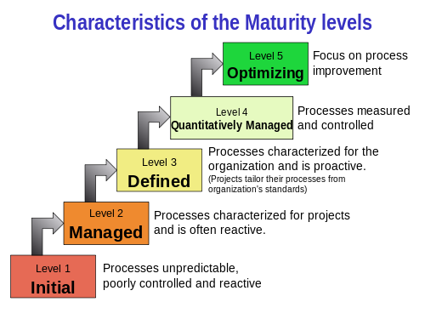

Slide 11
THANK YOU

